Slide 1
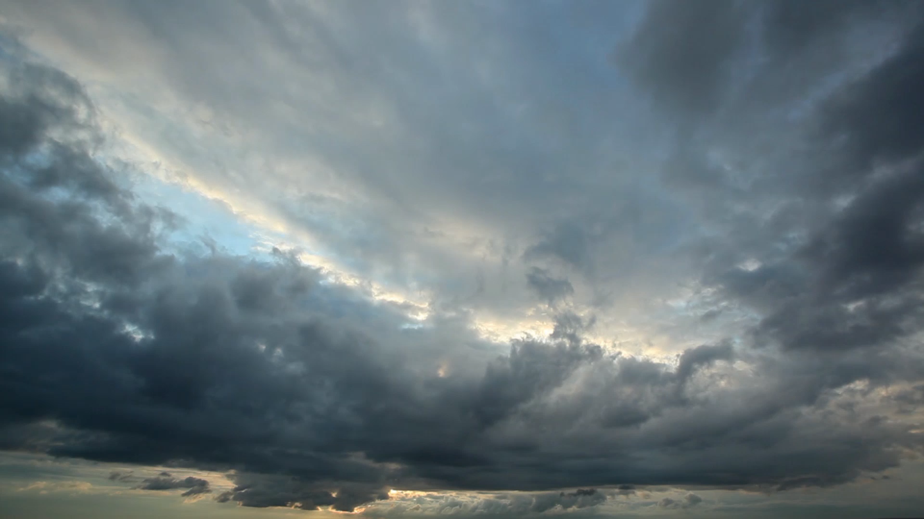
Big Mountain Case Study

Slide 2
Problem Statement
Big Mountain Resort recently installed an additional chair lift which increased operating cost by $1.54M
Investors would like to keep profit margins at 9.2% and need to understand how to maintain the profit margin with the addition of this new expense
This project will use data from other ski resorts to determine the increase in revenue required to maintain the desired profit margin

Slide 3
Recommendation
Big Mountain is currently the most expensive resort in Montana so is already perceived as a high-end resort. Modeling scenarios support ticket increases to generate more revenue and offset the cost introduced with the new ski lift.
*Assuming an expected 350,000 visitors skiing an average of 5 days
Extend the vertical drop
Close down a run
Closing a single run will not impact support for ticket price increases.
Ticket uplift of $2 for >$3M+ in revenue over the season
In the situation that multiple runs are becoming problematic, the model suggests that closing three, four, or five will not have an incremental effect in ticket price support. Therefore, if three runs need to be closed, it would be cost-effective to close five.

Slide 4
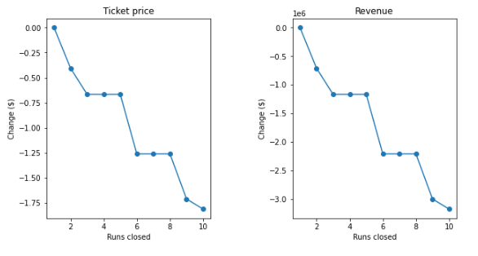
Modeling Results: Closing Runs
Closing a single run will not impact support for ticket price increases.
In the situation that multiple runs are becoming problematic, the model suggests that closing three, four, or five will not have an incremental effect in ticket price support. Therefore, if three runs need to be closed, it would be cost-effective to close five.

Slide 5
Summary
Big Mountain is already the most expensive resort in Montana so an increased ticket price would solidify its position as a premiere premium resort.
The recent chair lift addition has increased operating costs by $1,540,000 this season, this equates to an additional $.88 per ticket assuming 350,000 visitors purchasing 5-day tickets each.
The top scenario for increased revenue is to extend the vertical drop by adding a run serviced by a new chair lift that extends the vertical drop by 150 feet. The model suggests this could support a ticket price uplift of almost $2, equating to well over $3M revenue over the season.
The cost-cutting exercise of closing some runs could be tried with just one run. The model suggests this doesn't impact support for ticket price. However, if there were a few runs becoming, say, difficult or expensive to maintain, the model may provide a guide that we may as well close five as close three.

